Slide 1

Automated Test Generation with EvoSuite
Software Testing - Spring 2023
Bardia Ardakanian Aylar Sedaei

Slide 2

Introduction
A testing tool that uses advanced techniques to automatically generate test suites for software programs.
Leverages Abstract Syntax Trees (AST) to analyze program structure and generate tests that cover all possible paths through the code.

Slide 3
Exploring the Hidden Costs of Testing in Software Development
Many software companies tend to cut down on testing costs in order to meet project deadlines or reduce overall expenses.
This approach can lead to serious consequences, such as software bugs, crashes, and even security vulnerabilities.
Companies may also choose to outsource testing to third-party providers to reduce costs, but this can also result in lower quality testing and less control over the testing process.
Notes:
1. Time Constraints: Companies may have tight deadlines to launch their software, which leaves little time for thorough testing.
2. Limited Resources: Testing requires resources such as hardware, software, and skilled personnel. Companies may not have enough resources to test software properly.
3. Compatibility Issues: Software must be tested on different operating systems, devices, and browsers. Compatibility issues can arise due to the complexity of the software environment.
4. User Requirements: Companies must ensure that their software meets the requirements of their users. Testing must be done to ensure that the software is user-friendly and meets the needs of the target audience.
5. Security Concerns: Security is a significant concern for companies. Testing must be done to ensure that the software is secure and that there are no vulnerabilities that can be exploited by hackers.
6. Regression Testing: Companies must ensure that new features do not cause any issues with existing functionality. Regression testing is necessary to ensure that the software remains stable after changes are made.
7. Cost: Testing can be expensive, especially if companies need to hire external testers or invest in new testing tools. Companies must balance the cost of testing with the benefits of having high-quality software.
8. Communication: Effective communication between developers, testers, and other stakeholders is essential for successful testing. Miscommunication can lead to delays, errors, and other issues.

Slide 4
Is Software Testing Difficult?
Testing software can be a complex and time-consuming process.
It requires an understanding of the system's functionality, as well as the ability to simulate different use cases and scenarios.
Manual testing is often prone to human errors and can be repetitive, leading to testers overlooking important issues or becoming bored and uninterested.
As the software grows in complexity, the testing process becomes more difficult, making it harder to ensure complete test coverage.

Slide 5
What is automation test generation and few tools that automatically generate tests
Automated test generation is the process of automatically creating test cases for a software system.
This can be achieved using different techniques, such as model-based testing, symbolic execution, and search-based testing.
There are various tools available that automatically generate tests, such as EvoSuite, Randoop, and CodePro Analytix.
These tools use different approaches and algorithms to generate tests, such as genetic algorithms, machine learning, and constraint solving.
Automated test generation can reduce the overall testing effort, improve test coverage, and help identify defects earlier in the software development lifecycle.

Slide 6
Challenges of Automated Testing
Generating tests that provide full coverage of the code can be challenging, especially for complex programs.
Identifying and dealing with edge cases and boundary conditions can be difficult.
EvoSuite addresses these challenges by leveraging advanced techniques such as Genetic Algorithms and Symbolic Execution.

Slide 7
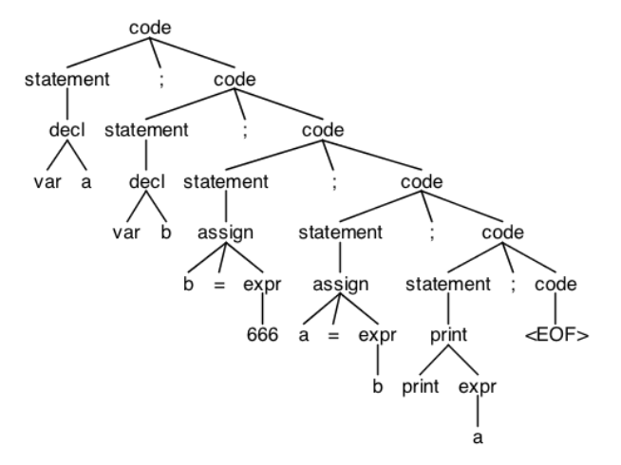
What are AST?
A way to represent code as a tree structure that shows its syntax and structure.
Helps developers understand and manipulate code more easily.
Used by EvoSuite to analyze program structure and generate tests.

Slide 8
How do AST work?
AST works by breaking down source code into its constituent parts and organizing them in a tree structure.
The process of building an AST involves parsing the source code to identify the different syntactic elements, such as keywords, operators, and variables. The parser then constructs a tree structure that represents the syntactic relationships between the elements. Each node in the tree represents a syntactic element, and the edges between nodes represent the syntactic relationships between them.

Slide 9
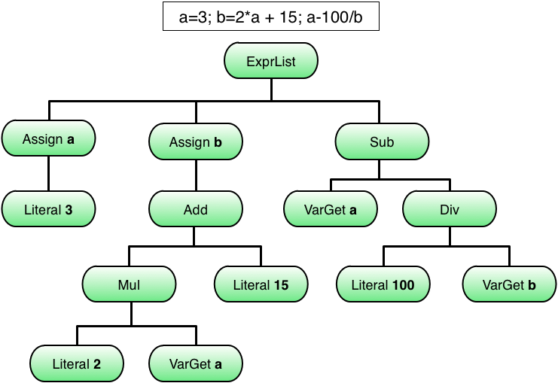
AST Example

Slide 10
Extracting Test Cases from AST
One of the benefits of AST is that it can be used to automatically generate test cases for software.
By exploring the paths through the AST, it's possible to generate test cases that cover all possible execution paths through the code. This can be a powerful technique for automated testing, as it can help to ensure that the software is thoroughly tested and free from bugs.

Slide 11

Introduction to EvoSuite
EvoSuite is a powerful tool that uses AST to generate JUnit test cases for Java software.
EvoSuite is a Java-based tool that can automatically generate JUnit test cases that provide complete coverage of the code. It uses a combination of dynamic analysis, optimization algorithms, and search techniques to generate test cases that are both effective and efficient.

Slide 12
How EvoSuite Works
EvoSuite works by analyzing the AST of a Java program and generating test cases that cover all possible paths through the code.
EvoSuite uses advanced optimization algorithms to generate test cases that are both effective and efficient.
It starts by analyzing the AST of the program to identify all possible execution paths through the code. It then generates test cases that explore these paths using a combination of dynamic analysis and search techniques.

Slide 13
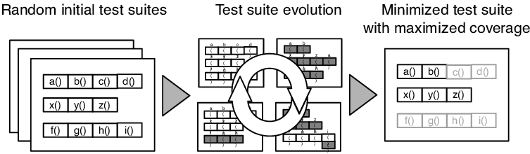
How EvoSuite Works

Slide 14
Benefits of EvoSuite
Automatically generates test cases, saving time and effort in manual testing.
Provides complete coverage of the code, including complex control flow structures.
Helps improve software quality by catching bugs earlier in the development process.

Slide 15
EvoSuite Drawbacks
Limited support for advanced language features and frameworks (Doesn’t work with JDK+8)
Difficulty in generating complex tests with multiple inputs and states
Generated tests may not fully cover the code, leading to potential undiscovered bugs
High computational and time costs for generating tests in large codebases (May take hours even days!)
Generated tests may be difficult to maintain and update as the code evolves
Lack of human intuition and creativity in test generation may result in missing important edge cases or test scenarios

Slide 16

Takeaway on EvoSuite
While EvoSuite can be a useful tool for generating initial test suites and reducing manual testing effort, it has its limitations and should be used in conjunction with other testing techniques to ensure thorough test coverage.

Slide 17




Setting up EvoSuite
Install and configure EvoSuite using a build tool such as Maven.
Use a command-line interface or a plugin for an Integrated Development Environment (IDE) such as Eclipse.

Slide 18

Sadly, Maven is sufficient

Slide 19
Generating Tests with EvoSuite
Specify the program to be tested and the configuration options for generating tests.
Run EvoSuite and wait for the tests to be generated.
Refine the generated tests as needed using advanced options such as fitness functions and test seeds.

Slide 20
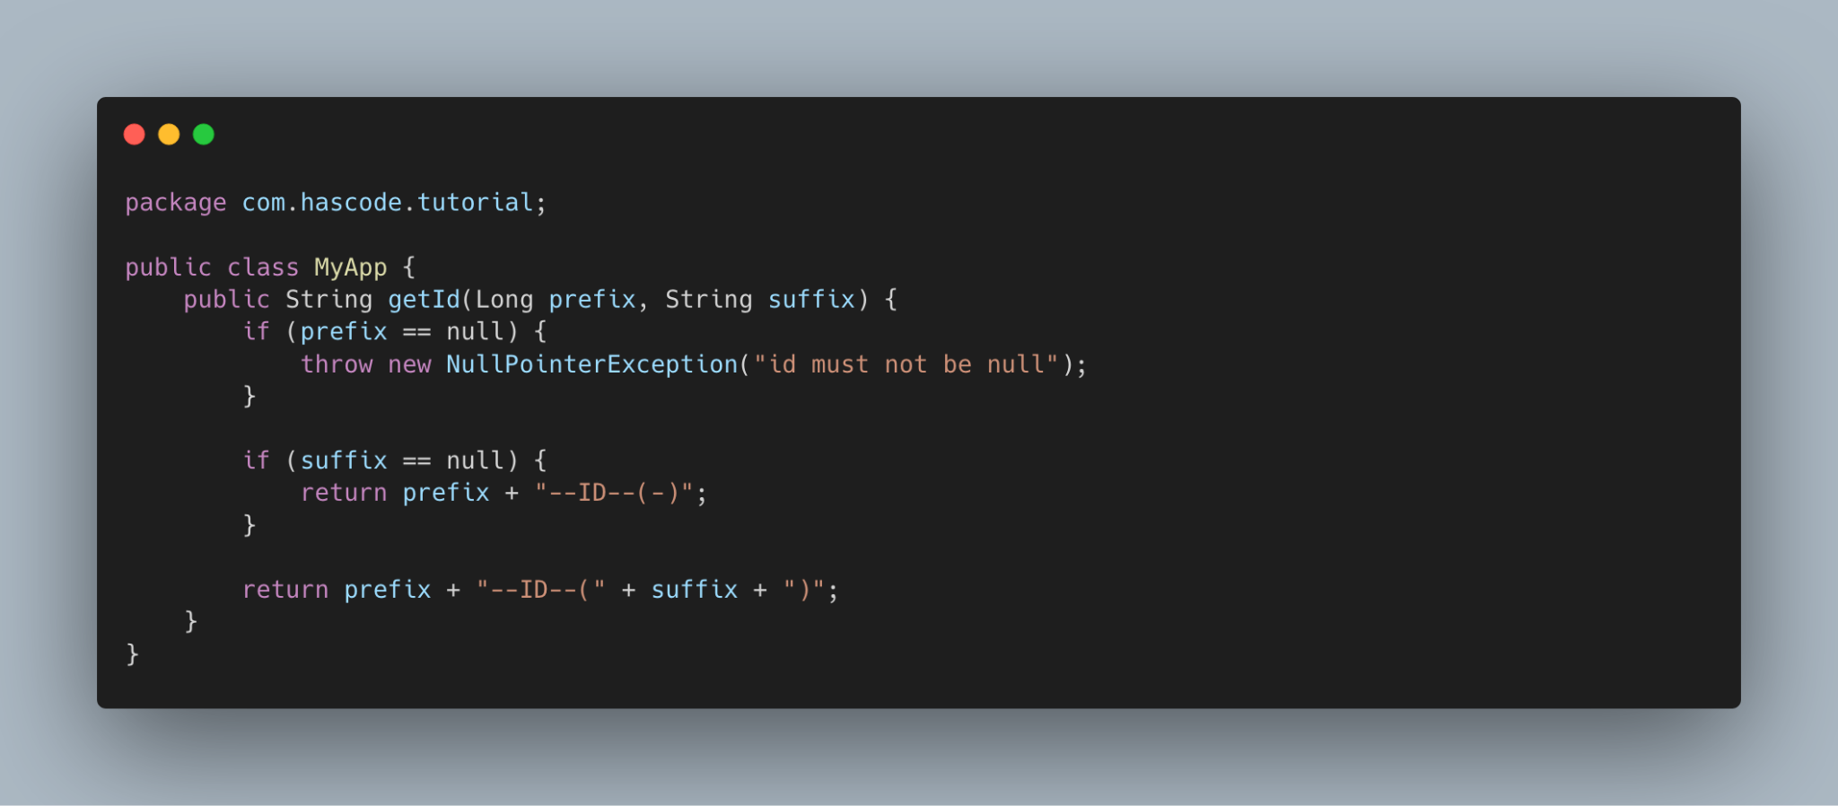
Java Example - EvoSuite

Slide 21
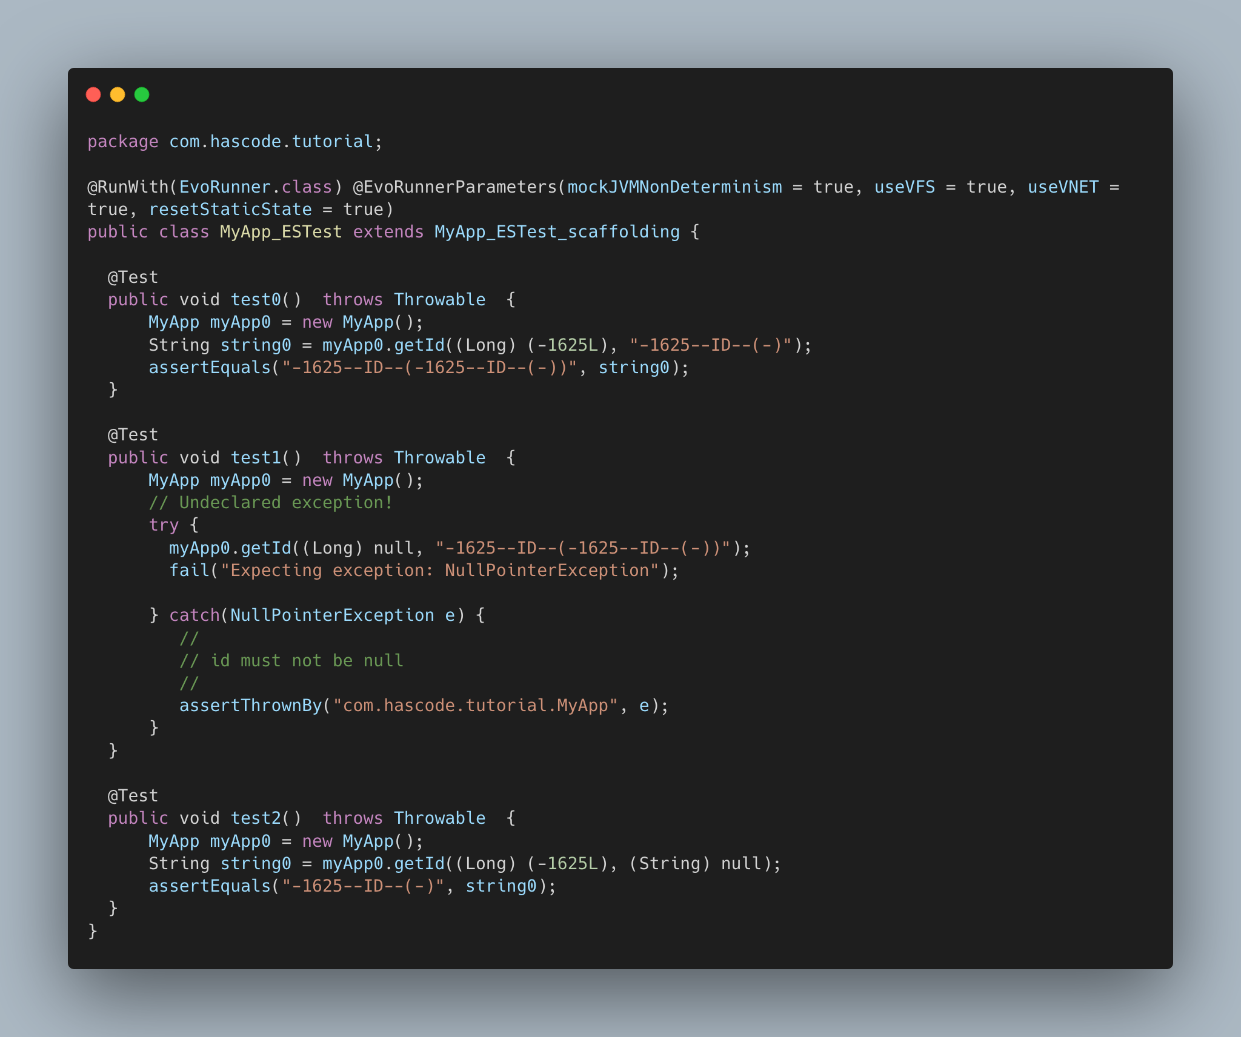

Slide 22

Conclusion
EvoSuite is a powerful testing tool that can save time and effort in manual testing and improve software quality.
Using Abstract Syntax Trees (AST) to analyze program structure, EvoSuite generates tests that cover all possible paths through the code, even for complex control flow structures.
By following best practices and using advanced options, EvoSuite can help testers work more efficiently and effectively.

Slide 23
Thank you. Please feel free to ask any questions. Bardia.ardakanian@gmail.com
Aylarsedaei@gmail.com

